Slide 1

Medical Claim Data – 1st Dive
NumInformatics, May 2023

Slide 2
Content
I. Objective
II. Modeling methodology
Modeling process - overview
Data cleaning
Feature Engineering
Sampling
Feature Selection
Three models
Logit model
Association rule learning
Decision tree model
III. Next Steps
Appendices

Slide 3
Objective
Use the data of 17m records of claim data to infer rules used by analysts to deciding whether to file a claim or not.

Slide 4
II. Modeling methodology Modeling process - overview
Step 1
Data Cleaning
Use business rules and data analysis to remove the following variables:
Unrelated to patients or providers such as edits-related columns
Variables that should not be used for decisioning.
Step 2
Feature Engineering
Most columns are in texts. They need to be encoded to numeric values for modeling.
Medical codes encoding.
Step 3-1
Propensity score based on logistic regression
Step 3-2
Derived rules based on association rule learning
Step 3-3
Derived rules based on decision tree model
Select 50,000 or more records with highest propensity score and with claims filed to find main drivers behind.
A set of if-then statements can be generated to infer rules used by analysts.
A set of if-then statements can be generated to infer rules used by analysts.
The three methods provide insights from different perspectives.

Slide 5
II. Modeling methodology Data Cleaning based on business rules
Only services received by patients and providers’ information can be used for decisioning. We exclude the following fields:
Edits-related information should be not be used for decision.
Columns for ID’s as they usually do not carry meanings.
Note: Prefixes and suffixes of providers are retained as they usually mean types of services.
Patient-related information that should not be used for decisioning such as
Age
Gender
Length of Service

Slide 6
1I. Modeling methodology Data Cleaning based on data analysis
We use Information Value (IV) to get a preliminary view of predictive powers of usable columns.
Claim-amount related columns are most predictive.
Edit-related columns are very predictive, but they cannot be used.
Patient’s age, gender and length of service received are not predictive.
No variable transformation is needed to run IV evaluation, but text variables cannot be directly used for modeling without transformation
Source: 095-2013: Variable Reduction in SAS® by Using Weight of Evidence and Information Value

Slide 7
II. Modeling methodology Text encoding
Predictive modeling and machine learning require that all columns should be expressed in numbers.
Medical codes encoding for following attributes:
Diagnosis code
Product code
Provider specialty category code
Procedure code (CPT I, CPT II and CPT III)
Definitions of the following codes cannot be found. Their flag value was appended as a suffix to the variable:
Place of service code
Revenue code (encoded to rvnu_0000, rvnu_0240 and rvnu_other)
The first two codes already account for 95% of all revenue codes.
Provider’s TIN prefix code
Provider’s TIN suffix code

Slide 8
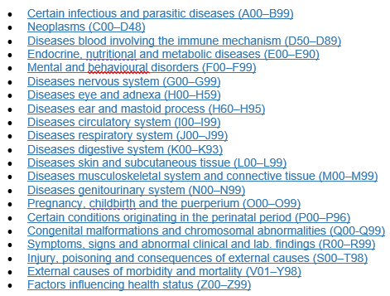
II. Modeling methodology Feature engineering
Diagnosis codes:
Example of encoding
Procedure CPT® Category II codes:
Composite Measures (0001F–0015F)
Patient Management (0500F–0584F)
Patient History (1000F–1505F)
Physical Examination (2000F–2060F)
Diagnostic/Screening Processes or Results (3006F–3776F)
Therapeutic, Preventive, or Other Interventions (4000F–4563F)
Follow-up or Other Outcomes (5005F–5250F)
Patient Safety (6005F–6150F)
Structural Measures (7010F–7025F)
Nonmeasure Code Listing (9001F–9007F)
More granular classifications of each code is not encoded. Otherwise the data will explode in size and encoded variables will be too diluted for modeling.
Procedure CPT® Category I codes:
Evaluation & Management (99202–99499)
Anesthesia (00100–01999)
Surgery (10021–69990)
Radiology Procedures (70010–79999)
Pathology and Laboratory Procedures (80047–89398)
Medicine Services and Procedures (90281–99607)

Slide 9
II. Modeling methodology Sampling
Entire Sample
17,462,662 records
30% random sample
5,245,933 records
Modeling sample and validation sample
70% (modeling)
30% (validation)
Down sampling due to limited computing power:
3.7 GHz
64GB ram
Increasing sample size will increase run time considerably.
- Further sampling down for running association rule.
- Use a balanced sample to run decision tree model

Slide 10
II. Three Models
Three models ran in parallel. They provides insights from different perspective
Q: Which factors play the most important roles for filing a claim?
Q: Which factors are usually considered together?
Q: What rules can we extract from the data?
Step 3-1
Propensity score based on logistic regression
Step 3-2
Derived rules based on association rules
Step 3-3
Derived rules based on decision tree model
Select 50,000 or more records with highest propensity score and with claims filed to find main drivers behind.
Pros: Clear and wholistic revelation of important factors. Can be used for redrafting rules for a majority of claims.
Cons: No rules extracted. Some variables might not perform as expected.
A set of if-then statements can be generated to infer rules used by analysts.
Pros: Gives suggestions on which rules should be considered together in developing new rules.
Cons: Computationally expensive and cannot handle large large. Can only expand combinations of different factors gradually.
A set of if-then statements can be generated to infer rules used by analysts.
Pros: Exact rules can be generated.
Cons: Rules tend to look fragmented with no easy ways to interconnect or integrate them.

Slide 11
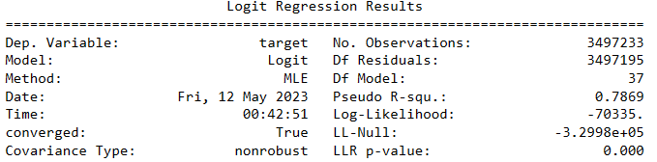
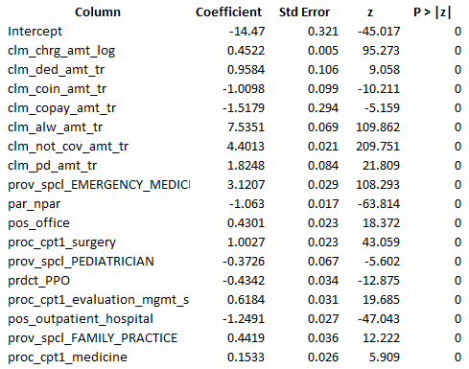
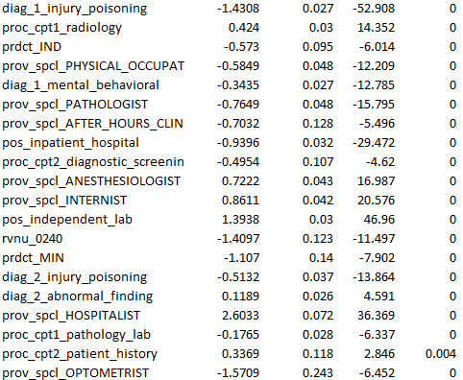
Model I – Logistic REgression
We want to find the most important factors (or columns/variables) that impact the filing of a claim.
Regression algorithm

Slide 12
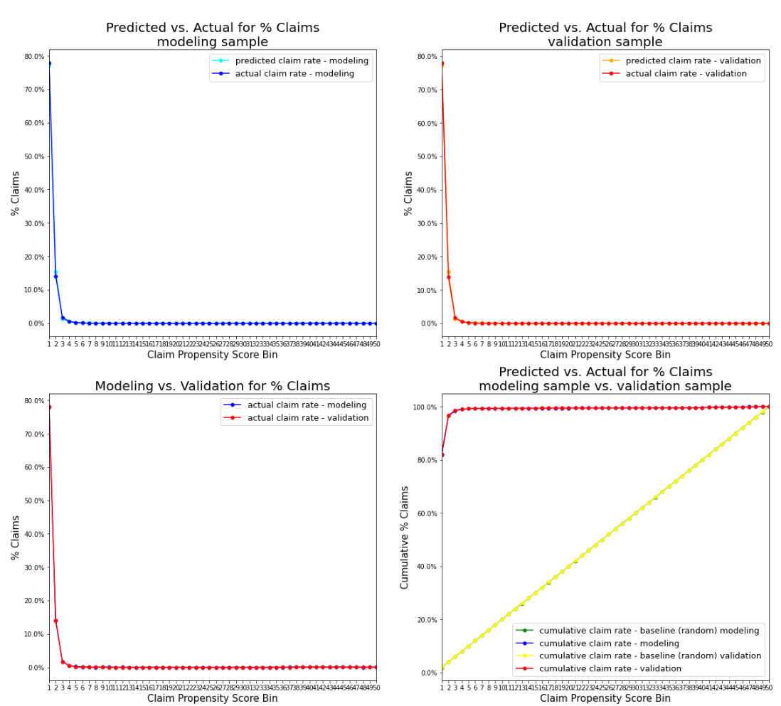
Model I – Logistic Regression performance
After the algorithm for claim propensity score has been generated, it will be applied to the validation sample.
The propensity score will be divided into 50 evenly distributed bins for performance evaluation. The boundaries of between bins are based upon modeling sample
Summary of performance:
- The model performs strongly and stably.
- % claim is 78% in 1st bin (about 2% of records).
- % claim drops to 14% in 2nd bin and 1.6% in 3rd bin.
- % claim is very close between prediction and actual.
- % claim is 78% in 1st bin (about 2% of records).
- % claim drops to 14% in 2nd bin and 1.4% in 3rd bin.
- % claim is very close between prediction and actual.
- If there are 1000 records with 19 claims, 16 claims can be found in top 20 records.
Performance by validation sample looks very similar to that of modeling sample.

Slide 13
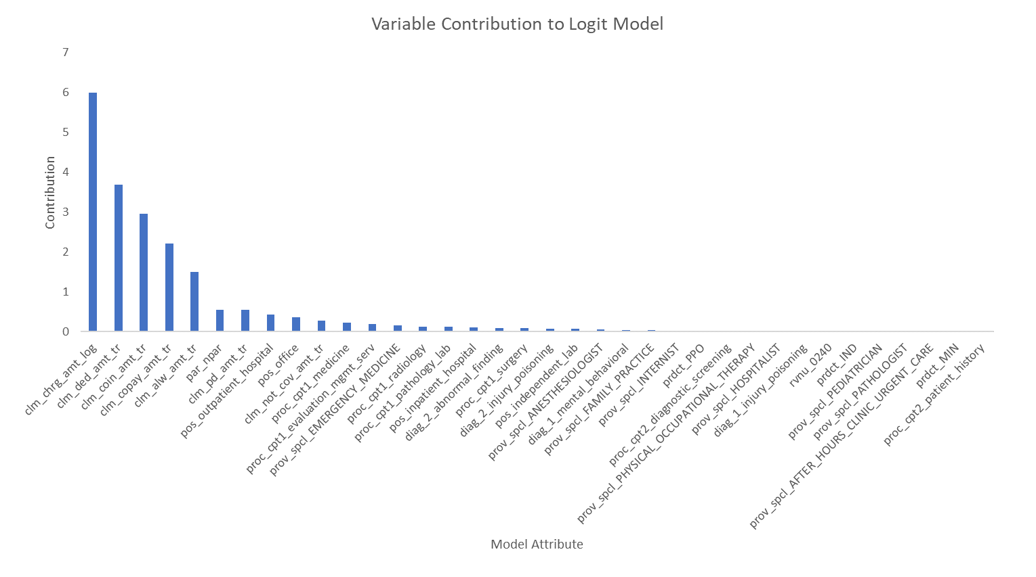
Model I – Finding the top drivers for model score
(See the appendix for the method used.)
Key takeway:
- All amount-related attributes play key roles, with clm_chrg_amt as the most important one.
- par_npar (0 or 1) is also an easy-to-use attribute.

Slide 14
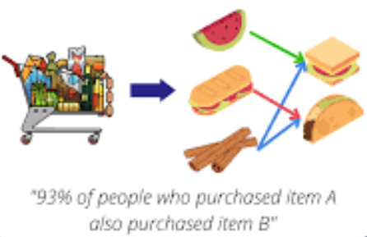
Model 2 – Association Rule learning
Originally called market basket analysis, association rule learning studies which items are usually purchased together by customers.
In our exercise, we want to find out which factors (must =1) are considered together by analysts. It might also suggest high correlation between two or more factors.
It is a method of unsupervised learning. That is, it does not consider how factors considered together will impact filing of claims. However, in this exercise we only selected those records with claim=1 for study. (A more rigorous exercise is to create another set of association rules for claim=0).

Slide 15
Model 2 – Association Rule learning
These two factors are often considered together
It is very computationally expensive to rule association rules. We can only work on a much reduced sample.
Currently we can deduce association between two factors. We can expand to > 2 factors manually. It will take time.

Slide 16
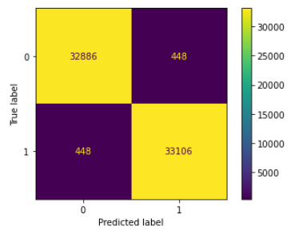
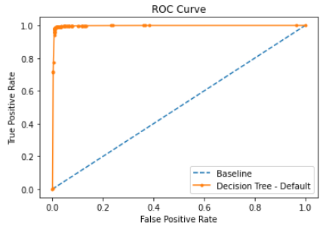
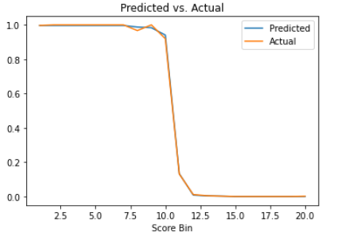
Model 3 – Decision Tree Model based on a validation sample (balanced)
Accuracy: 0.987
Precision: 0.987
Recall: 0.987
F1 Score: 0.987
If we convert the segments of trees into a probability estimate, we will a clear separation between claim=1 from claim=0;
Baseline: ROC AUC = 0.500
Default: ROC AUC = 0.996

Slide 17
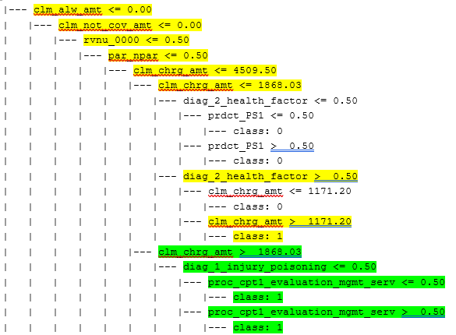
Model 3 – Decision Tree Model Extracting rules from the model
How do we see the rules?
Step 1: Find class: 1 at the bottom
Step 2: Select all conditions before class: 1
Rule 1: if clm_alw_amt <=0 and clm_non_cov_amt <=0
and rvnu_0000=0 and par_npar=0
and clm_chrg_amt between 1171.20 and 1868.03
and diag_2_health_factor=1
then claim=1
Rule 2: if clm_alw_amt <=0 and clm_non_cov_amt <=0
and rvnu_0000=0 and par_npar=0
and clm_chrg_amt between 1868.03 and 4509.05
and diag_1_injury_poisoning=0
then claim=1
I doubt whether an analyst will use diag_1_injury_poisoning=0 (meaning no such diagnosis) for decisioning. Many rules will contain such =0 as a part. This is a drawback of the decision tree model.
See the complete set of rules in a separate file.
<= 0.5 means =0. 0.5 means =1. This is how the tree output codes dummy variables.

Slide 18
III. Next steps
Association rule learning can be enhanced if needed. This will take some more time.
Try more modeling methods:
Machine learning
Deep learning
Clustering

Slide 19

Appendix 1 – Method for finding top drivers in a logistic regression - find which variables have higher predictive power - generate contributing factors
Step1: Run the regression by using original variables (the following is if for illustration only)
Step2: Calculate contribution power by each variable:
contribution= coef_est*x as in
Step 3: Rank order the contribution by each model variable from highest to lowest for each observation.
Compare the magnitude of each component

Slide 20
Appendix 2 – Finding the top drivers for model score
Select those records from 1st bin of the validation sample and with claim=1.
Rank all model variables from 1st to last by their magnitude of contribution to the model score.
Select top 6 variables that have contributed most (see appendix for the method).
Calculate the total contributions of each variables after assigning weights 6, 5, 4, 3, 2 and 1, with 6 to top contributor and 1 to 6th contributor.
Calculate the total contribution of each variable.
Rank the contributions of all variables from highest to lowest.

